Slide 1
Raytracing
Forward, Backward Raytracing;
Ray/Surface Intersections;
Aliasing; Distribution Raytracing;

Slide 2
Bouncing Photons
We usually think of light as a bunch of little particles (photons) flying around.
Each photon has a wavelength and energy.
So it’s more physical than Phong shading...
When photons hit things they bounce, losing at least some of their energy. When they lose most of it we declare them to be absorbed.
The light intensity of an image pixel is determined by the rate at which photons hit, and by their energies. The color is determined by distribution of the wavelengths of incoming photons.
A light bulb sends photons streaming out in all directions.
If we know how to model the way photons bounce, we’re done. All we need to do is follow each one through its chain of bounces, until it either
  a) run out of steam
  b) departs the known universe, or
  c) strikes the image, in which case we add its contribution into the appropriate model.

Slide 3
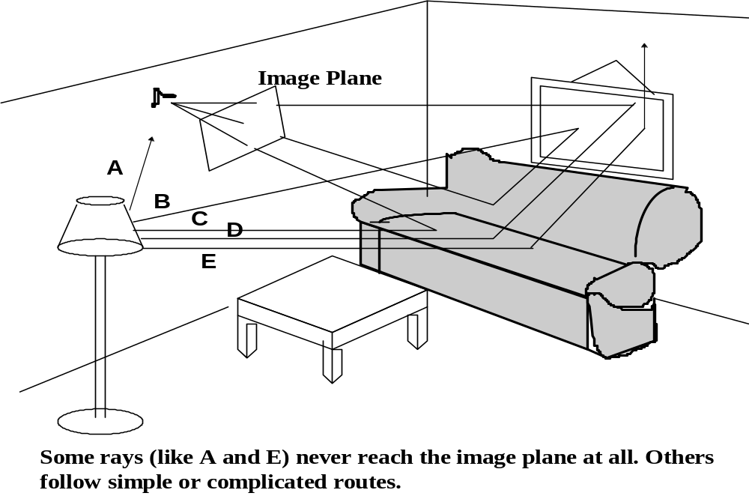
Tracing Rays

Slide 4
Forward Raytracing
The trajectories that the photons follow seem like rays.
So, when we followed them over successive bounces we must have been ray tracing.
The procedure that is described is called forward raytracing for the reason that we’re moving from the light source, just the way the light does.
There’s a big problem with forward ray tracing:
The universe is pretty big and the cameras are pretty small. Almost all the rays originating at the source wind up anywhere but the image.
Since what we want to do is synthesize images, tracing all that junk is a total waste of time.
Ideally, we would like to magically know at the outset which tiny subset of rays eventually contribute to the image, and just trace those.

Slide 5
Backward Raytracing
The solution is to go backward: trace outward from an image pixel until the ray finds (or fails to find) its way to a light source.
Here is the basic logic:
  Each image point gets light from just one direction (the line through the image point and the focal point).
  Any photon that contributed to the point’s color had to come from there.
  If we happen to hit a light bulb, we’re done.
  If we fly straight through to the blackness of space without hitting anything, we’re also done.
  If we hit a surface, we recursively ask where the light impinging at that surface came from by shooting out more rays.
In the end we’ll have done the equivalent of forward ray tracing but only examining those rays that actually contributed to the image.

Slide 6
Kinds of Rays
Let’s start with a simple world, containing:
  You, the viewer, with your pinhole camera.
  Objects: of the light that hits their surfaces, part is reflected, part is absorbed, and part (if they’re transparent) is transmitted.
  Point light sources.
All of this is sitting in an optically inert medium, say hard vacuum.
For convenience, we’ll distinguish four ray types:
  Eye or Pixel rays, the ones that bring light directly to the image.
  Illumination rays, that bring light directly from a light source to an object surface (sometimes called shadow rays)
  Reflection rays, carrying light reflected from a surface.
  Transparency rays, carrying light passing through an object.

Slide 7
Surfaces
As we just saw, you follow an eye ray until you hit something (or fail to). The recursive problem is to figure out the color and the intensity of the light emitted to the eye from the thing you hit.
If you hit a light, you get the answer directly from the source’s properties.
If you hit a surface, then you perform the shading calculation, using the model of your choice-Phong, or something better-exactly as we’ve already learned to do. However, we’ll extend the model to account for transparency.
To perform the shading calculation, you need to fill in some blanks, for the illumination arriving at the surface, called the incident illumination.
Previously, we’d filled in the blanks just by blindly adding up the effects of some point sources, plus the ambient illumination.
Instead we will recursively fire the three remaining kinds of rays-illumination, reflection, and transparency rays.
Remember that what we’re doing when we recurse is calculating the incident illumination, to fill in the blanks in the shading model, so that we can perform the shading calculation to determine the light to send back along the ray that hit us.

Slide 8
Illumination Rays
Here’s our model for the incident illumination: light comes directly from each source to the surface, unless there is something in the way.
Light also comes in along two special directions: the reflected and transmitted directions, hence the other two kinds of rays, which we’ll get to shortly.
What about stuff coming in from the rest of the visible hemisphere? Forget about it! It only shows up in the diffuse term.
Illumination rays bring light from sources to the surface (the ‘‘L’’ vector in our shading model discussions).
The only reason we need them is to test whether something is in the way-the shadow buffer is another way to do the same test.
For this reason, they’re also called Shadow Rays or Shadow Feelers.
For each illumination ray that reaches the source, we add the corresponding term into the shading calculation, as we’ve already learned.

Slide 9
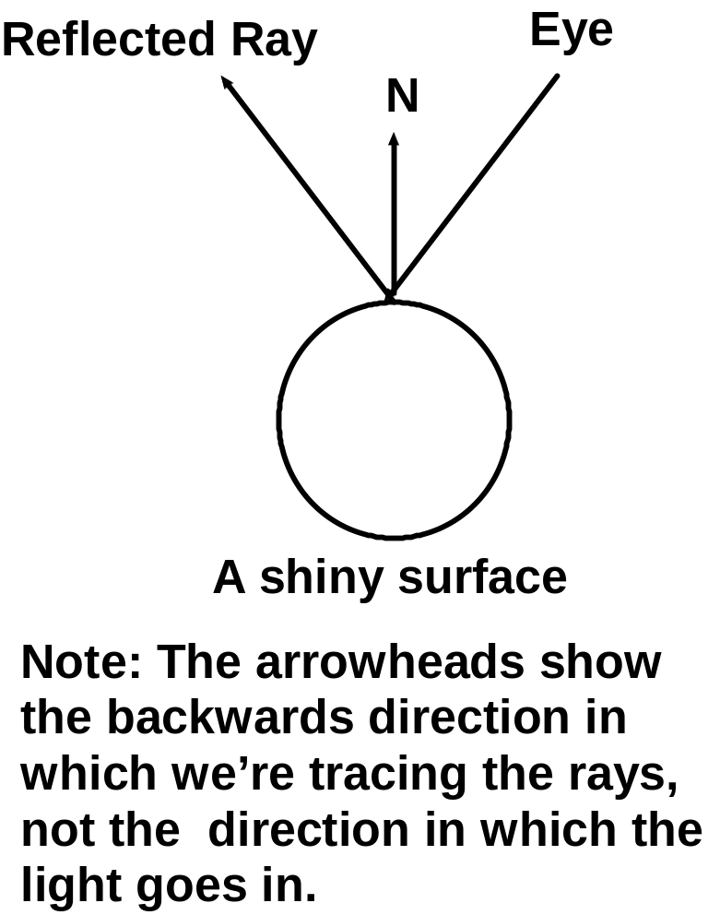
Reflected Rays
We already talked about this when we talked about the environment maps. But now we’re doing it for real.
An eye ray has just hit point P on a shiny surface. We know the surface normal at P, so we know what direction an incoming ray would have to produce a specular reflection along the eye ray: the mirror direction.
We recursively fire a ray in that direction, and add the light that comes back into the shading calculation, just as if it were a light source.
The reflected ray, once we fire it, is treated just like an eye ray-if it hits another surface, we do the shading calculation, which means firing off more rays...

Slide 10
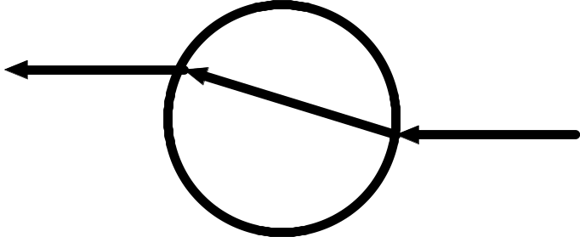
Transparency Rays
To add transparency to our shading model, we just add a term for that light that’s being emitted toward the eye from within the object.
The additional twist is that light rays are refracted, or bent, when they pass a boundary between two different media (say, air and glass).
When an eye ray (or a recursive reflection or transparency ray) hits the surface of a transparent object, we recursively fire a transparency into the object at the proper refracted angle, in addition to firing illumination and reflected rays.
The first thing this ray will hit be the surface of the same object, but this time exiting instead of entering. At this point we bend it again.

Slide 11
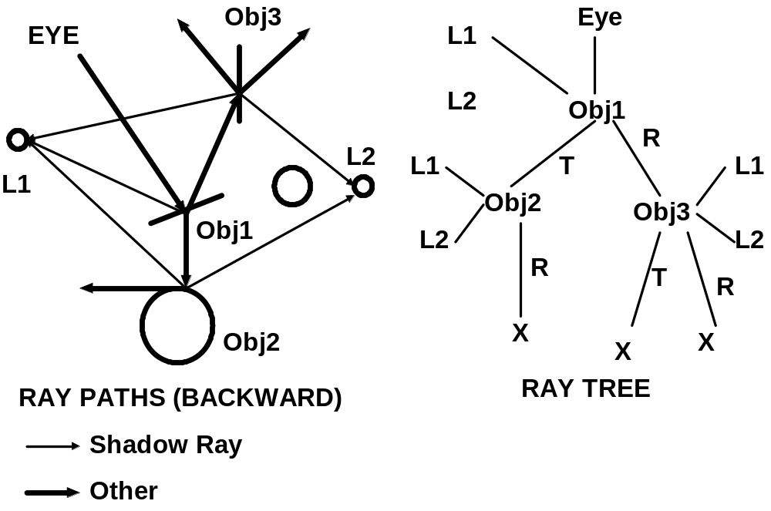
Ray Genealogy

Slide 12
A Schematic Dumb Ray Tracer
Raytrace() /* top level function */
For each pixel
color(pixel) = Trace(ray_from_pixel(pixel))
Trace(ray) /* fire a ray, RETURN RGB */
object_point=closest_ray_surface_intersection(ray)
if object_point return Shade(object_point, ray)
else return Outer_Space_Color
Shade(point,ray) /* return color emitted by */
/* surface in ray intersection */
for each light source
if Shadow_Feeler(point, ray, source)
add_light(source)
if shiny(point)
add_light(Trace(reflected_ray(point, ray)))
if transparent(point)
add_light(Trace(refracted_ray(point, ray)))
return emitted_color(point, ray, lights)
Closest_ray_surface_intersection(ray)
find every point of intersection of each object with the ray. Return the closest intersection in a bundle that contains info such as surface normal, pointer to surface color info, etc.

Slide 13
Ray/Surface Intersections
Here’s one standard way to write down a ray equation, in terms of a starting point, a direction, and a parameter t:
x(t) = x₀ + tv
There are two ways to represent surface:
  Implicit functions: f(x) = 0
  Parametric functions: x = f(u, v)
The implicit surface/ray equation has one unknown, t, while the parametric surface/ray equation has three t, u, v. Obviously, implicit surface are easier to deal with.
The problem is to find the roots of these equations.
In either case, we get the intersection equations by substituting the ray equation into the surface equation
f(x₀ + tv) = 0 or x₀ + tv - f(u,v) = 0

Slide 14
Ray/Surface Intersection (cont.)
One of the major problems of ray tracing is that there’s no neat, quick way to solve the general intersection problem.
After all, in the general case it’s an arbitrary non-linear root finding problem in 1 or 3 unknowns.
On a case-by-case basis, sometimes you get the closed-form solutions and mostly you can’t.
General purpose numerical methods are expensive, and usually not guaranteed to converge. When you’re repeating the operation millions of times, that means guaranteed not to converge, at least sometimes.
Happily, ray tracing lends itself to a modular object-oriented style. For each surface primitive, you want to handle you implement best specialized method you can manage. The ray tracer lets each object handle its own intersections.
Among the surface primitives that admit direct solutions are low-order polynomials, quadrics (sphere, cylinder), cone, ellipsoid, paraboloid, hyperboloid, tori, superquadrics, and of course planes and polygons.

Slide 15
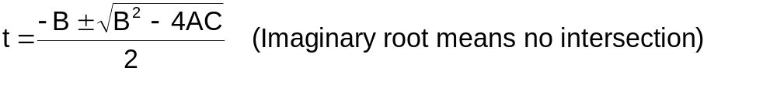
Ray/Sphere Intersection
You see lots of spheres in ray traced images because ray/sphere intersection is the easiest case of all. We’ll go through it as an example-you can get the rest from Glassner’s book (An Intro. to Ray Tracing) if you need to.
A sphere’s implicit function, written out in components, is x² + y² + z² -r²= 0
The ray equation, also in components, is
x = x₀ + tv_{x}
y = y₀ + tv_{y} Substitution gives (x₀ + tv_{x})² + (y₀ + tv_{y})² + (z₀ + tv_{z})² - r²= 0
z = z₀ + tv_{z}
which is quadratic equation with t the only unknown.
We reduce it to standard form
A=v_{x}²+v_{y}²+v_{z}²=1 (unit vector)
At²+Bt+C=0 where B=2(v_{x}x⁰ + v_{y}y⁰ + v_{z}z⁰)
C=x₀²+y₀²+z₀² - r²
and the quadratic formula gives the two solutions

Slide 16
Antialiasing
The recursive ray tracing algorithm defines a color for every point in the image. If we point-sample this function at a single point per pixel, we alias. The obvious way to reduce aliasing is to oversample (supersample), shooting out more than one ray per pixel.
The simplest oversampling strategy is to divide each pixel into an nxn grid, say 3x3, fire a ray from each subpixel grid point, and average the colors that come back (possibly with spatial weighting) to get the pixel value. We’ve just multiplied our cost by 9.
We can do better by adaptive supersampling: Fire a ray at each of the four corners, and in the middle of each pixel. If the colors that come back are almost the same, we guess that we are hitting something homogeneous, and stop. If not, we recurse on each of four subsquares until it’s homogeneous.
Even with massive supersampling, you still get visible aliasing effects when the regular sampling grid interacts with regular structures (e.g., straight lines or regular textures). You can get very noticeable beating, moire patterns, etc.
The solution is to sample stochastically-instead of a regular grid, the subpixel sample positions are drawn from a random distribution.
When you sample stochastically, you can do adaptive sampling statistically. Keep taking samples until the color estimate converges, then stop.

Slide 17
Temporal Antialiasing
When things are moving, you can alias in time as well as space. The sampling rate is the frame rate, 30Hz for video, 24 Hz for film. When things are moving fast, they take big jumps from frame to frame, producing a jerky, strobed look.
The way you do temporal anti-aliasing automatically is by oversampling in time. The brute force way would be to compute frames, say at 120 Hz, then average them together with appropriate weighting. Then a fast moving object would be a blurred streak instead.
Real media (film and video) do temporal anti-aliasing automatically. Film integrates over the whole exposure time, and video cameras have persistence, or ‘‘memory.’’ This antialiasing shows up as motion blur in photographs.
Temporal anti-aliasing in ray tracing is handled neatly by distribution ray tracing, a generalization of stochastic sampling to time, as well as space.
Since you know how all your objects are moving, you can assign a time as well as an image position to each ray you fire. In addition to randomly picking intra-pixel ray positions, you randomly pick intra-frame ray times.
The result is beautiful still-frame motion blur, and smooth animation.

Slide 18
More about stochastic ray tracing
We’ve seen that to anti-alias, you fire more eye rays, distributed both in space and time.
Sampling at points drawn randomly from an appropriate distribution is an example of Monte Carlo Integration.
In place of aliasing, you get noise, which is less visually disturbing than jaggies, moires, strobing etc., and whose amplitude can be as small as you want (just fire more rays).
Remember that the real incident illumination on a surface is an integral of the incoming rays over the visible hemisphere.
Just as we can anti-alias by firing more rays, we can improve the incident illumination estimate by firing more shadow, reflection, and transparency rays.
Even without computing a montecarlo integral over the whole visible hemisphere you can compute selected important pieces of the integral, getting realistic effects that you would otherwise miss.

Slide 19
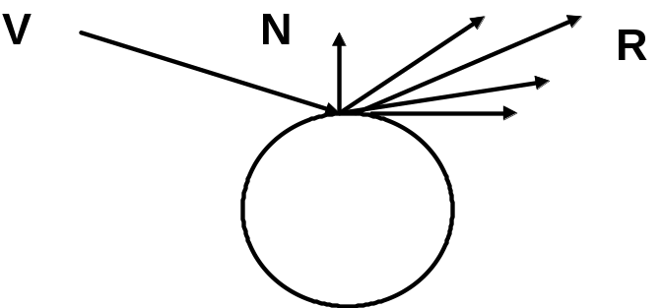
Gloss and Highlights
Simple ray tracing sends out a single reflected ray to capture the specular component.
Remember the shininess parameter (exponent inside the cos?) Unless it’s very big, the specular component actually gets a significant contribution from a whole cone around the central direction-this is what makes fuzzy, glossy highlights as opposed to hard mirror reflections.
If you just send out a single ray, you’re ignoring the shininess parameter. Because the cone is a very small piece of the visible hemisphere, you can sample it stochastically-with probability falling off sharply with the off-specular angle, to get soft highlights. You still see the reflections of other objects, but they’re blurred.

Slide 20
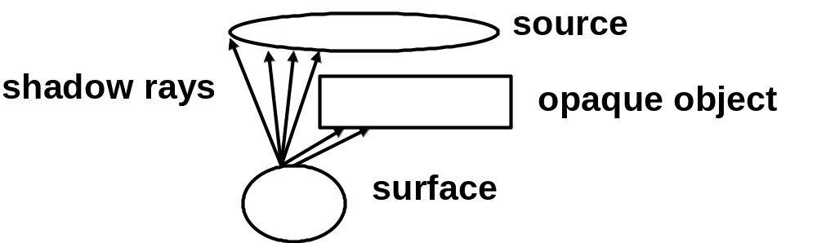
Extended light sources
With point sources a surface point is either shadowed or not. So shadow edges are totally sharp, and you only need to send out a single shadow ray.
An extended light source may be partially visible from a surface point, so that only part of the light arrives (partial eclipse).
The result is that shadow edges are soft. The region of transition from full shadow to full light is called the penumbra.
We can get this by stochastic integration: fire shadow rays at randomly chosen points on the source (weighted by how bright they are). The amount of light depends on the proportion of shadow rays that are unobstructed.

Slide 21
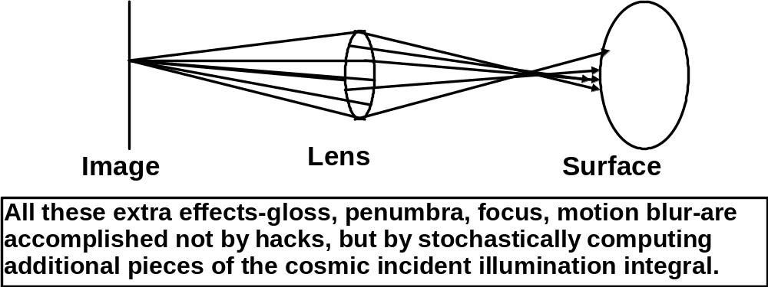
Depth of field
A pinhole camera is a convenient abstraction, but real optics are more complicated.
Because rays are focused onto the image by the lens, points project to disks, whose size depends on distance and on the lens. Small disk: in focus; big disk: out of focus.
The range of distances that appear in focus is called the depth of field.
To get the effect you do a montecarlo integral by firing eye rays through different points on the lens.

Slide 22
Beyond Ray Tracing
Raytracing punts almost entirely on the diffuse component of incident illumination.
Imagine sending out enough rays from each surface points to estimate the whole visible-hemisphere integral. And remember that the number you send out is the branching factor of your recursive ray tree!!!
Even if you could contemplate doing that, there’s a conceptual problem: If you start sending rays out in all directions, you’ll get loops: Point A gets some of its incoming light from Point B, and vice versa. Obviously, recursively sending rays back and forth between A and B won’t get you anywhere.
Real solution: solve simultaneously for incoming/outgoing light to/from all surface points. The big integral equation.
Easy case: purely diffuse scenes. Radiosity.

